Slide 1



Slide 2

Online 3D Jewelry Shop with Recommender
Supervised by:
Ma’am Sadia Ijaz
Group Members:
[Fizza qaseem] (CIIT/SP17-BCS-010/ATK)
[Aqsa amanat] (CIIT/SP17-BCS-004/ATK)
Presented on [7/04/2020]
Department of Computer Science
COMSATS University Islamabad, Attock Campus

Slide 3
Outline
_______________________________
Introduction
Related work
Objectives
Methodology
Tools and Technologies
Benefits
Embedding 3d models
3D Models
Recommendation
Context Level Diagram
Class Diagram
Use Case Diagrams
Activity Diagram
Sequence Diagram

Slide 4
Cont..
Conclusion.
Future Intention.

Slide 5
Problem Statement
Mostly jewelry website contains 2d models of jewelry.
2d models cannot give proper look.
2d models height dimension can never evaluate
2d models models reduced cell to cell interaction.

Slide 6
Solution to Problem
Adding 3D models to our website to increase visual perception.
3d models visualize to customer in such a way that attracts the customers.
Provide recommender to the user so that it buy products more conveniently.

Slide 7
Introduction to 3D modeling
3D modeling is the use of software to create a virtual three dimensional model of some physical object.
Used in many different industries, virtual reality, video games,3D printing ETC.
3D design allows the designer to see what they would not see in 2D.
3D object obtained complete replication of real object.

Slide 8
Introduction to recommender
Automate form of a “Shop counter guy”.
Recommend the relevant items to particular users.
text to read, products to buy or anything else depending
on industries.
Six types of recommender in media and entertainment industries.

Slide 9
Introduction to our website
Using 3D modeling and recommender system, I am going to develop a website that is “AQZA Jewelers”.
First of all the user will have to register in our website.
After registration and code confirmation, user will be able to select and view jewellery of their own choice.
View product image and also see the 3D model

Slide 10
Cont….
View the shopping cart and then make checkout.
User also remove the product after adding into the cart.
User also see the top selling and view products list.
Recommendation also shown to user to reduce the costs of searching and selecting item in online shopping environment.

Slide 11
Related Work
Name | Weakness | Proposed project solution
Daraz | All shopping items are 2D , which does not ensure user satisfaction. | All shopping items are in 3D model.

Slide 12
Objectives
To understand the 3D technology.
To import 3D Models of jewelry on website.
To understand web application tools.
To provide user a platform to buy jewelry online easily.

Slide 13
Methodology
Our System is design to built in incremental model.
Software development life cycle model where project/system is designed, built and tested incrementally.

Slide 14
Increments
Increment 1
3D Models
Increment 2
User Interface
Increment 3
3D model integration
Increment 4
Back End Development

Slide 15
Tools and Technologies
Tools | Version | Rationale
Ms Word | 2015 | Documentation
Power Point | 2015 | Presentation
Brackets | 2.8 | Web interface
Blender | 2.8 | 3D models
Visual Paradigm | 2010 | Software Design

Slide 16
Benefit
A customer will be able to see 3D jewellery model.
3D viewer on their websites in a manner that customers can see from 360 degree all attributes of the jewelry clearly including textures, sizes, colors and many more.
By seeing jewellery in 3D shape customer will easily select the jewellery and buy it.

Slide 17
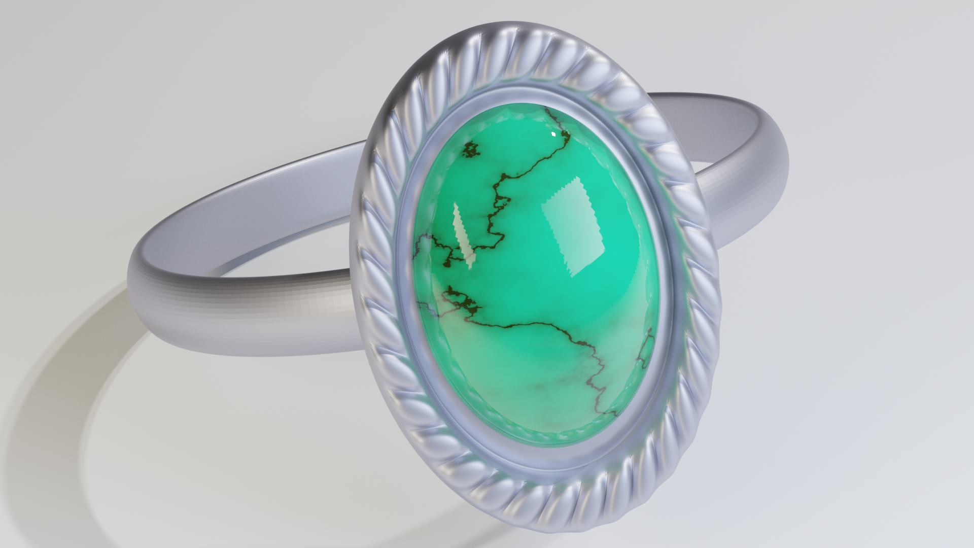
3D Models

Slide 18
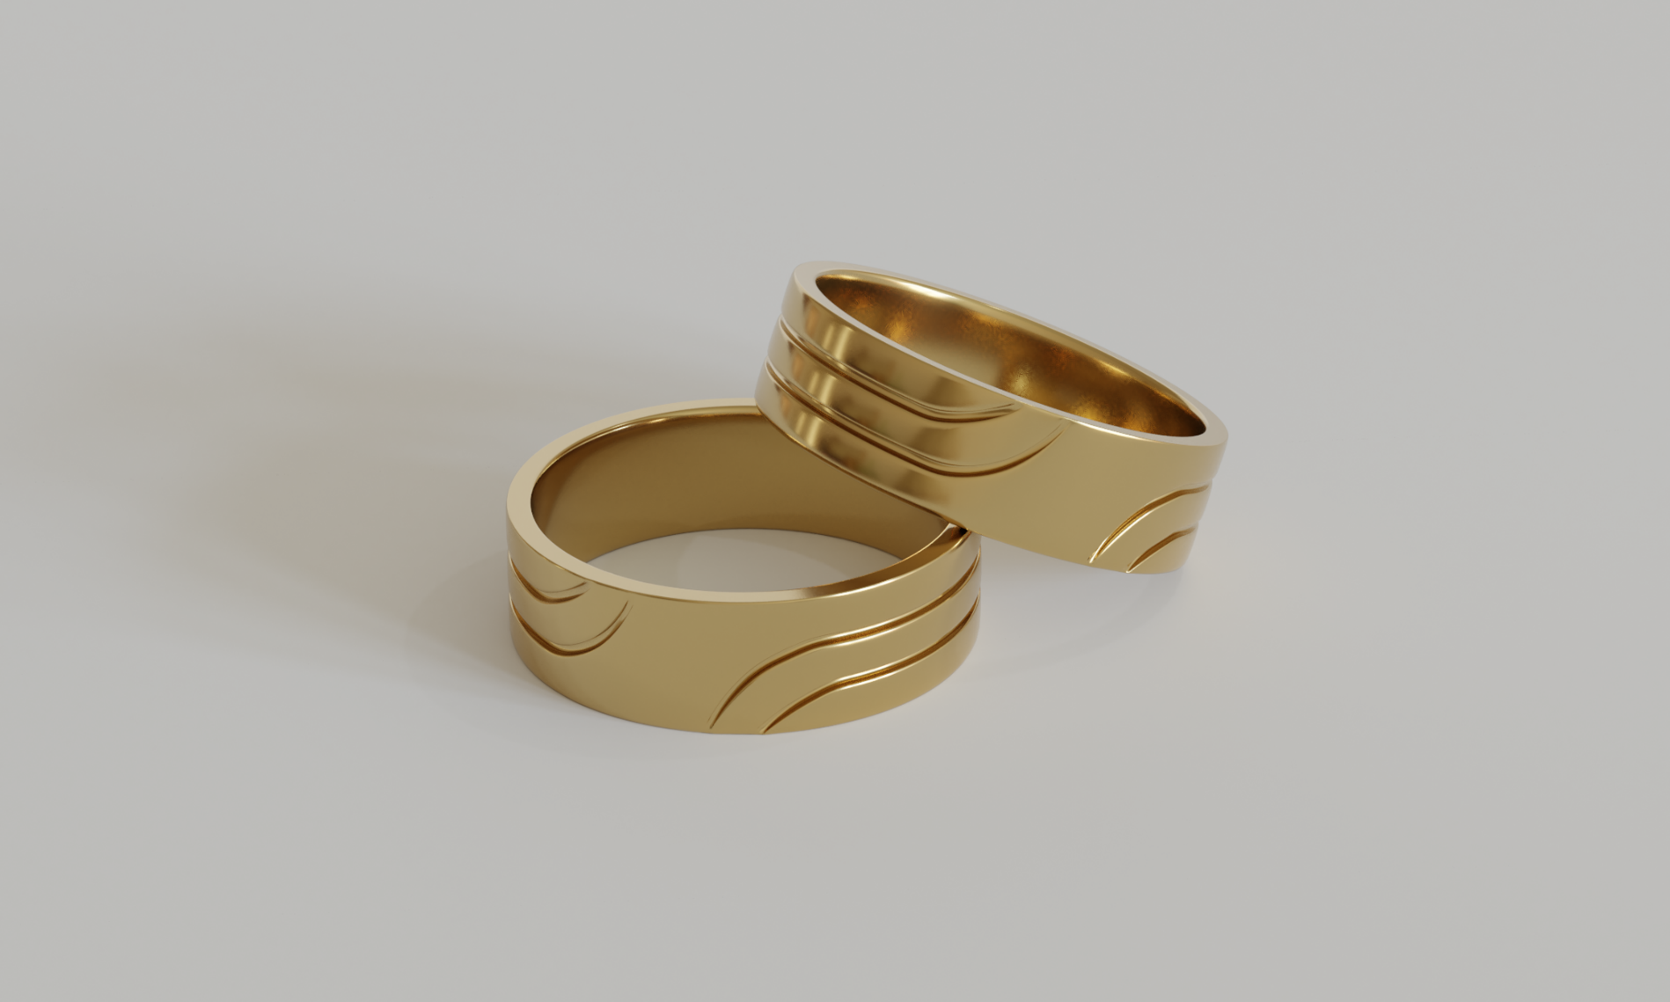
Cont…

Slide 19
Models Explanation
Extrude duplicate vertices, keeping the new geometry connected with the original vertices.
Loop Cut and Slide tool creates a cut through the whole loop you select.
Subdivision Surface modifier used to split faces of a mesh into smaller faces, to give smooth appearance.
Join is selection based, To attach multiple objects together first they must be selected.
12/6/2020
19

Slide 20
Models Explanation
Use plane for lightning scene.
Blender Render window displays output as its being processed.
Rendering is the process of turning a 3D scene into a 2D image.
Larger the value is better the 2d image.
Larger the value is longer time take to render.

Slide 21
Embedding the 3d model
Adding polymer JavaScript library open-source JavaScript library for using Web Components.
web component is basically it is a custom HTML element built from standard web platform features, it behaves for all intents and purposes.

Slide 22
Recommender work
Users personalization and profiling plays very important role for the successful web sites.
Personalized recommender are getting more popular with the evaluation of technology and internet.
Recommendation system basically are data filtering tools.
It is beneficial to both service providers and users.
Collaborative filtering depends on the like or desire of the other users
we implement user based collaborative filtering by using the parameter of user rating.

Slide 23
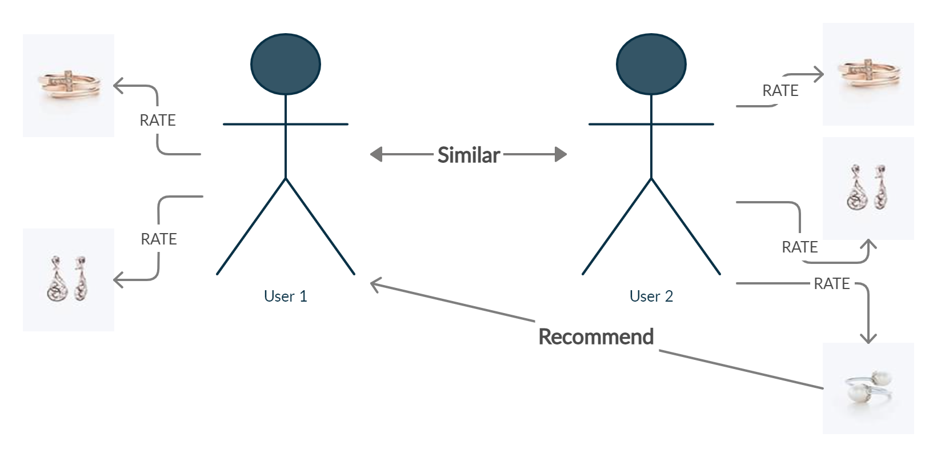
User base collaborative filtering

Slide 24
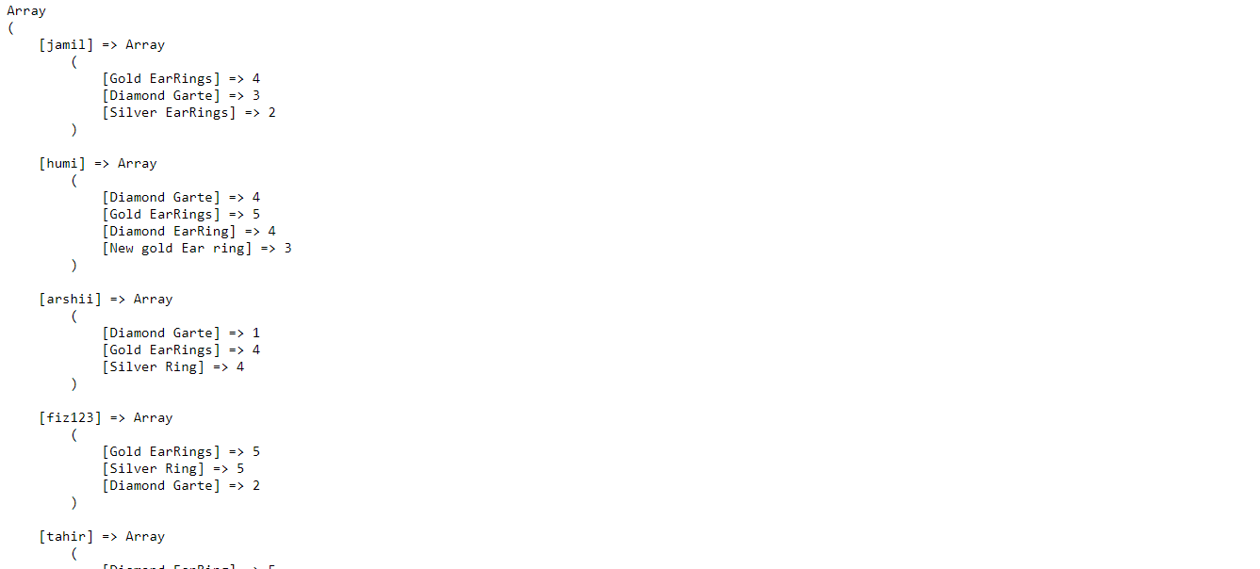
Implementation steps for recommendation
First we get the rating from the user in different products.
Store the ratting in the database to used the data further.
Now we make the matrix of every user in which we get the products along with the ratings.

Slide 25
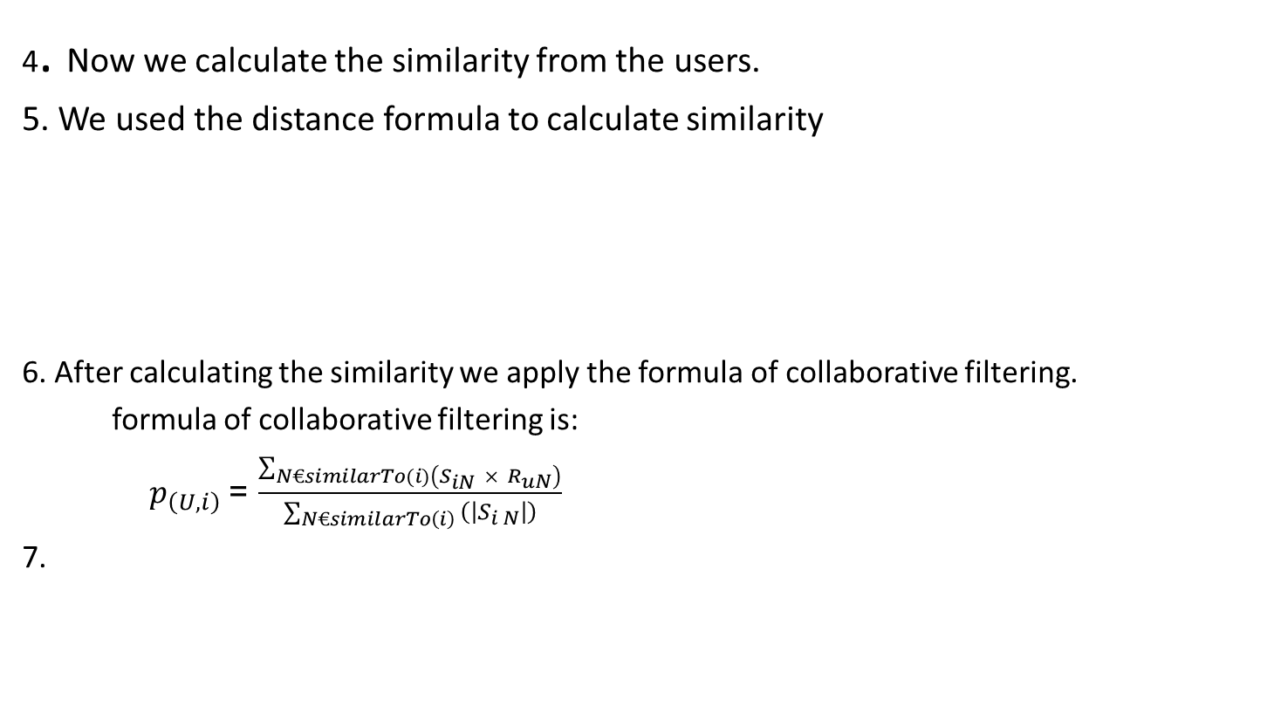
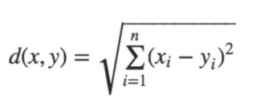
Cont….

Slide 26
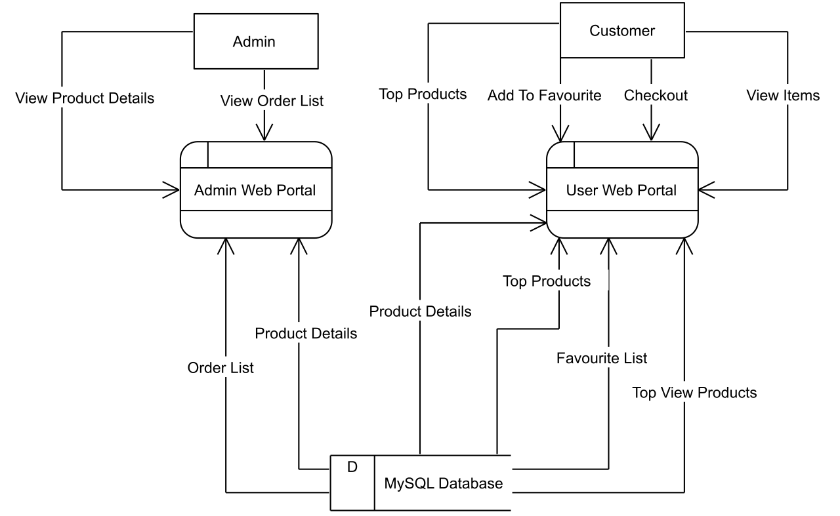
Context level diagram

Slide 27
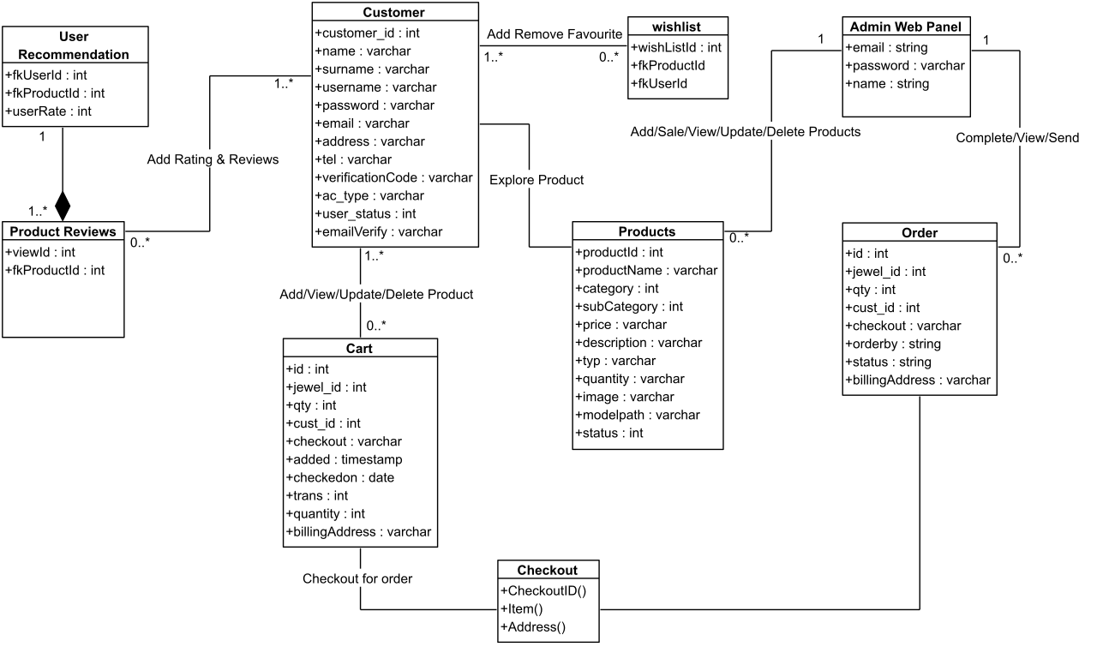
Class diagram

Slide 28
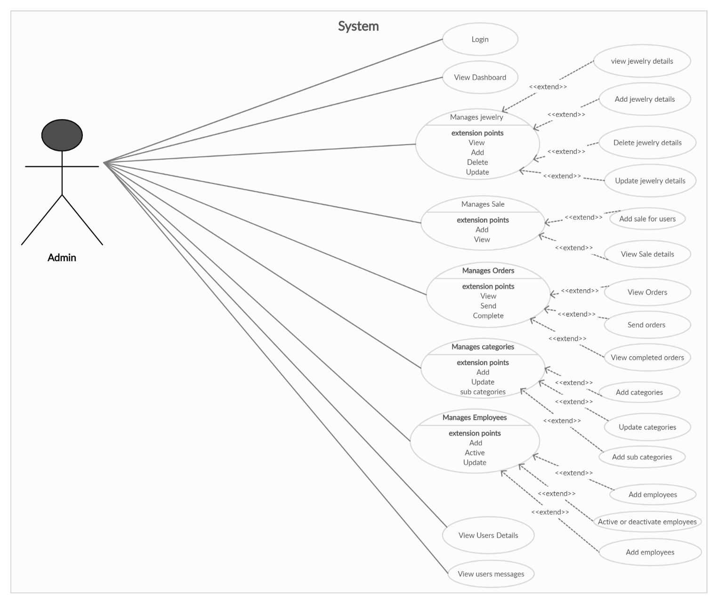
Admin Use case diagram

Slide 29
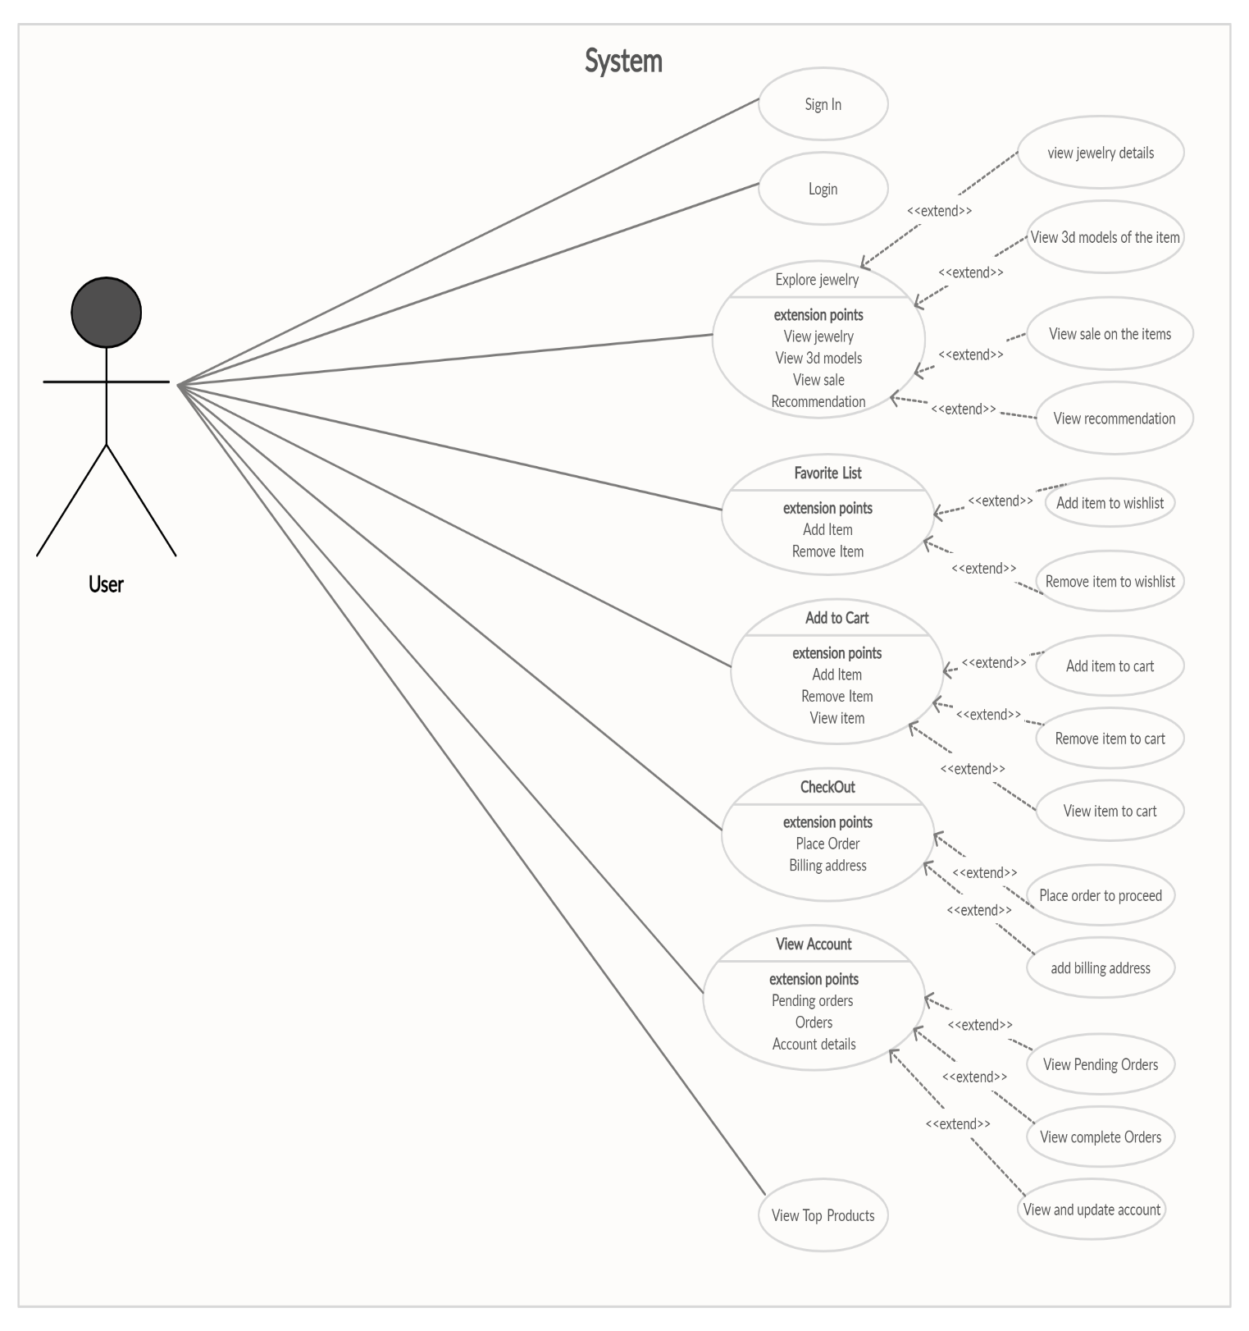
Customer Use Case Diagram

Slide 30
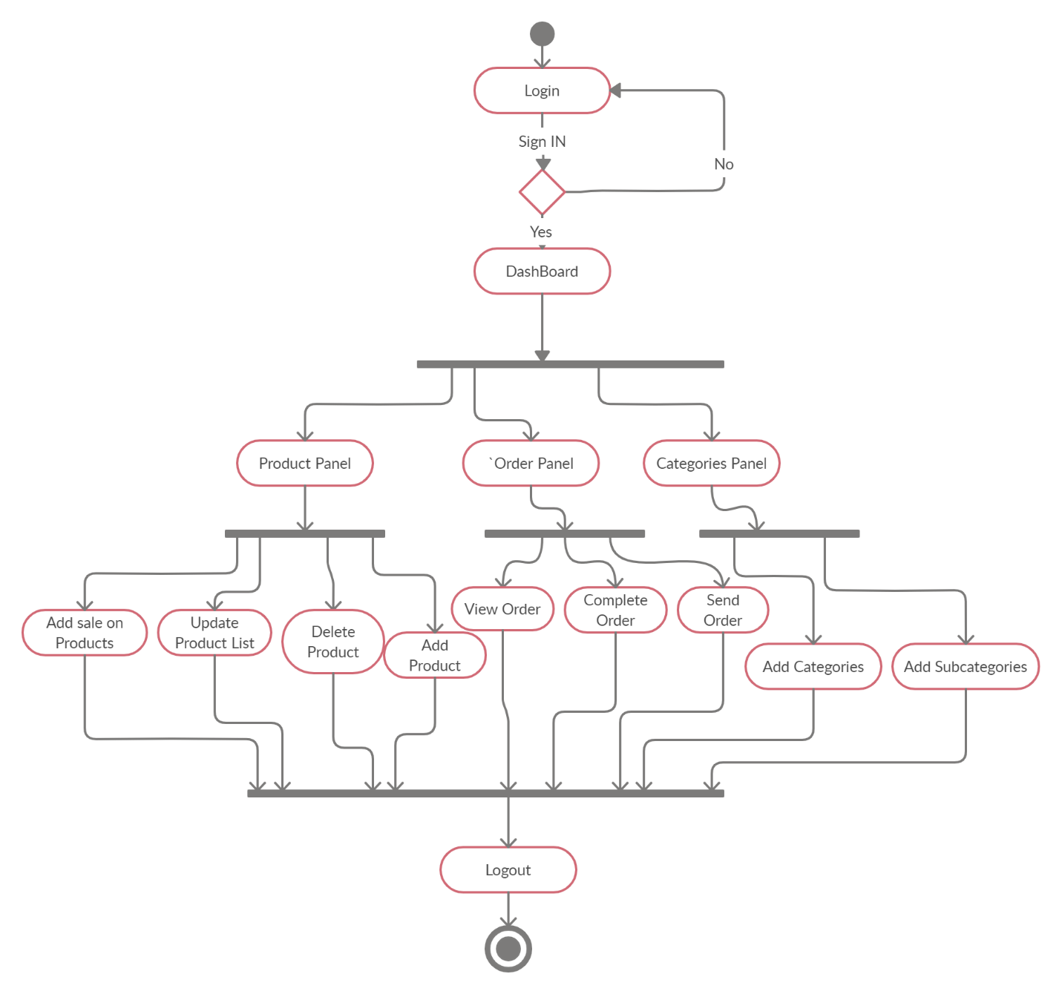
Activity diagram

Slide 31
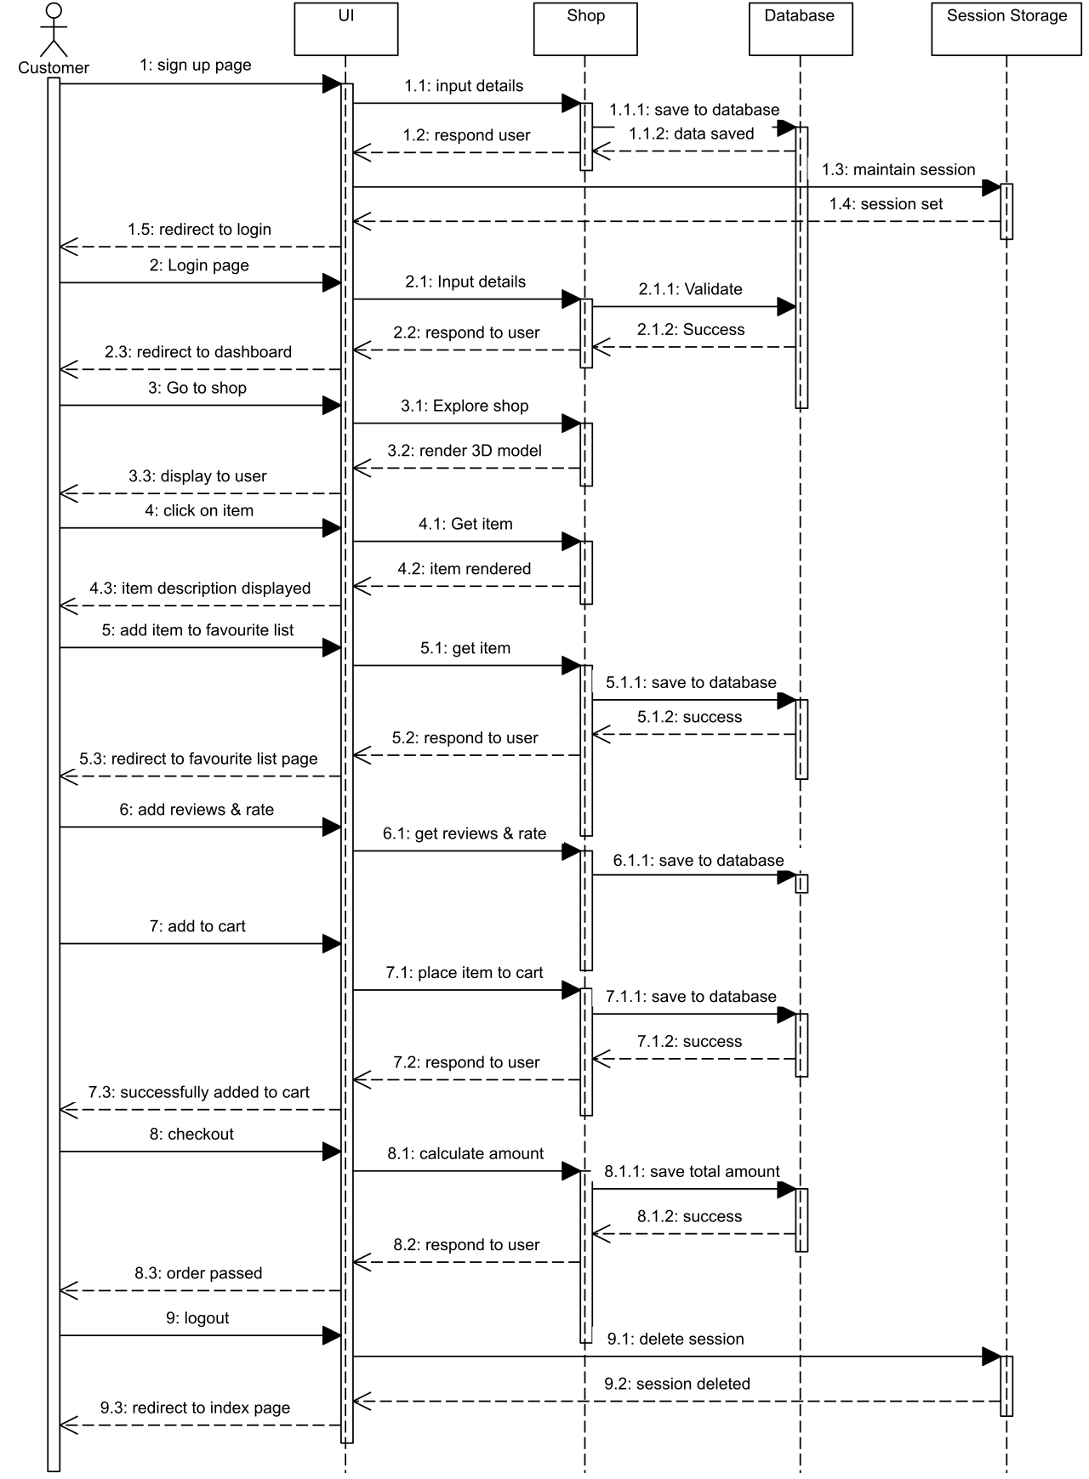
Customer Sequence Diagram

Slide 32
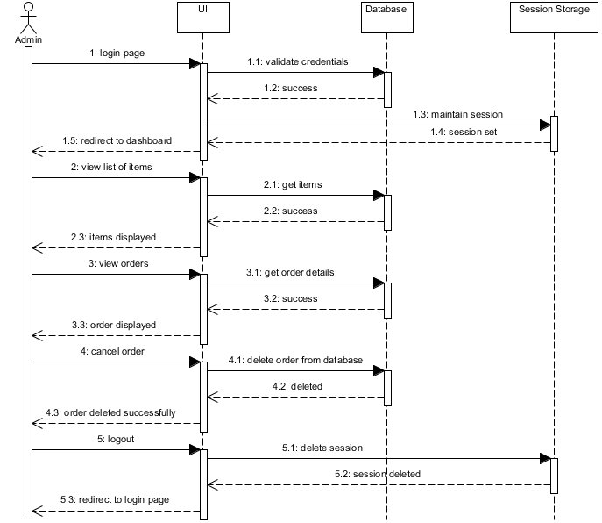
Admin Sequence Diagram

Slide 33
Conclusion
We provide the solution in the form of online website named as “AQZA Jewelers” .
By adding the 3d models of jewelry and display in our website.
We also provide recommendation with the use of user base collaborative filtering algorithm on the basis of users ratting.

Slide 34
Future Intention
We will be add seller that it will become mega website.We will add other products as dresses and shoes in our website and view them in 3dimension.When we will add these products we also apply recomander on the products.
We will be add virtual trial room in which users will add his images and jewelry will shown on her image.They will try different jewelry products on their image to check the jewllery.

Slide 35
Cont…
Now recommendations are shown on the basis on ratings. We can used different algorithms as in collaborative filtering we can use matrix factorization.Recommandations can shown on basis of user interest as user buys products related to that product recommendations are shown to him as darz.com show recommendations.

Slide 36


